Slide 1








Weekly Training 2:
Best Response Guide & Overall Justification
Asha Rebellya Prince

Slide 2
Today’s Training Agenda 📚
What We’ll Cover Today:
🏆 Best Response Guide (🚨 –20 Straight Fail)
Comparing Response A vs Response B
Applying the Golden Rules
Choosing the correct winner
📝 Writing Overall Justification (🚨 –20 Straight Fail)
✅ Trainer Self-Audit

Slide 3
01
🏆 Best Response Guide

Slide 4
🏆 Best Response Guide
Step 1 – Review the Evidence 🕵️
Before choosing a winner:
You should have reviewed both responses
You should have answered all required evaluation questions
You should have evidence, not opinions.
Now your job is to:
Make a final decision.
Defend it clearly
[NOTE: Your decision is based on performance and not personal preferences!!!]

Slide 5
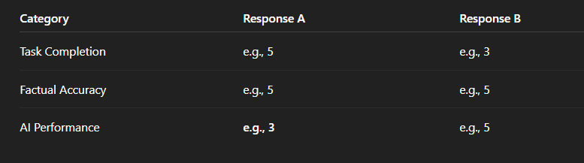
Step 2 – Compare Scores Side-by-Side ⚖️
👉 Look for where the differences are, not just totals.

Slide 6
Step 3 – 👑Apply the Golden Rules
👑 Rule #1: Correctness Is King
Task Completion and Factual Accuracy always come first
A response that is incorrect or incomplete cannot win, no matter how polished it looks
👔 Rule #2 – Performance Is the Tie-Breaker
Use AI Performance ONLY when:
Task Completion scores are equal
Factual Accuracy scores are equal

Slide 7
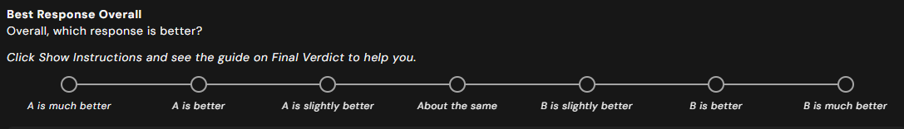
Step 4 – Winner-Selection Scale

Slide 8
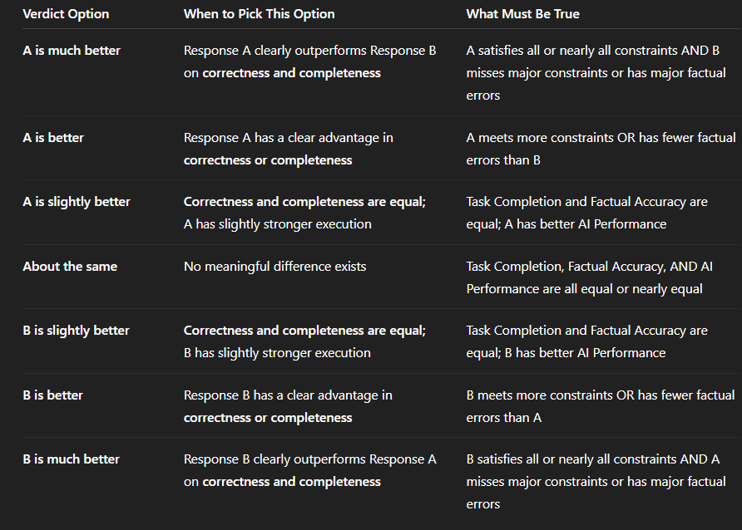
🏆When to Pick Each Option

Slide 9
02
📝 Writing Overall Justification
Do not copy justifications within a task, even if the responses are very similar, and do not reuse justifications across different tasks. This is strictly not allowed.

Slide 10
Section 1: Scores
Response A Scores:
- Task Completion: [Your Rating]
- Factual Accuracy: [Your Rating]
- AI Performance: [Your Rating]
Response B Scores:
- Task Completion: [Your Rating]
- Factual Accuracy: [Your Rating]
- AI Performance: [Your Rating]
Example:
Response A Scores:
- Task Completion: [5]
- Factual Accuracy: [3]
- AI Performance: [5]
Response B Scores:
- Task Completion: [2]
- Factual Accuracy: [1]
- AI Performance: [1]
NOTE: For Cannot confidently assess in Factual Accuracy, use “Cannot confidently assess.” You do not have to use numeric scores or N/A.

Slide 11
Section 2: Final Verdict
Use the winner selection scale to write your final verdict!
Final Verdict: [e.g., Response A is much better.]
[NOTE: Do not select About the same unless the responses are truly identical. If possible, look for even subtle differences in AI Performance before choosing this option.]

Slide 12
Section 3: Justification
Should be 50+ words (no ONE liners)
Explain the reason for your final recommendation (referencing the scores and Golden Rules)
Example: Response A is recommended because it included the required product link, which the user explicitly asked for. Response B identified the correct item but missed this key requirement and thus failed in task completion. Since task completion takes priority over performance, Response A is the correct choice.
Explain the most important difference that led to your choice
Example: Response A navigated directly to the relevant page, avoided repeated or unnecessary steps, and presented the required information clearly. Response B took extra steps and opened unrelated pages, making the process less efficient.

Slide 13
Golden Example
Response A is the better response because it fully completed the task and all the sub-requests. It gave the user all the information they needed and included several links in the response, making everything very easy to verify. Response B included some core information, but did not provide a direct documentation link, which was a missed constraint. Since task completion and correctness are more important than performance, the missing link makes Response B less useful overall, making Response A the stronger response and the winner.
NOTE: Do not use any LLMs to write your justification, and do not use tools like Grammarly or Quillbot for spell checks. The client is not expecting fancy language. Simple, clear wording that explains all the requirements is what matters.

Slide 14
✅ Trainer Checklist
⬜ 🧠 Prompt understood (Main goal + ALL sub-requests. Yes, all.)
⬜ 📌 All constraints & expectations captured (No “oops I missed that” later.)
⬜ 📋 Should Do / Should Not Do present (Structure exists. Chaos does not.)
⬜ 🚫🤖 No AI used to evaluate (Not even “just to double-check.” Naughty.)
⬜ 🎯 Main goal fulfilled (The actual thing the user asked for.)
⬜ 🧩 ALL requirements & sub-requests fulfilled (“Almost” does not count.)
⬜ 🔍 Every objective claim identified (If it can be fact-checked, it must be.)
⬜ 📚 Every objective claim fact-checked (Trust issues encouraged.)

Slide 15
⬜ 🤔 “Cannot confidently assess” used when needed (Confidence ≠ guessing.)
⬜ 🧾 All claims included in justification builder (No claim left behind.)
⬜ 🔗 Sources added for each factual claim (Receipts or it didn’t happen.)
⬜ ✍️ Justifications are detailed (One-liners go straight to jail.)
⬜ 🤖⚙️ AI Performance evaluated (Navigation • Efficiency • Output)
⬜ 👑 Winner follows Golden Rules (Correct > Pretty. Always.)
⬜ 🔢 Scores match winner selection (Math is still real.)
⬜ 🧩 Winner selection matches justification (They should be friends.)
⬜ 📝 Final justification is 50+ words AND detailed enough (Length + substance. Both required.)
⬜ 🧠 Did I write this myself for this task? (No copy-paste, no repeats, no shortcuts.)

Slide 16
🕵️‍♀️🔍 Be the QA
It’s your turn to switch roles.
You are no longer the trainer.
You are the QA reviewer. 👀

Slide 17
01
User Prompt: Find me two budget-friendly hotels near Times Square, New York, for next weekend. Include prices, booking links, and briefly mention why each option is budget-friendly.
Response A:
Hotel Edison:
Located directly in Times Square. The price starts at $210 per night. This hotel is budget-friendly because of its central location and frequent discounts.
YOTEL New York:
About a 10-minute walk from Times Square. Prices start at $195 per night. It is considered budget-friendly due to its smaller room sizes and competitive pricing for the area.
Response B:
Hotel Edison
price: $210 per
night booking link:
https://www.hoteledisonnyc.com budget
friendly because central location
YOTEL New York price $195/
night link https://www.yotel.com
budget friendly smaller rooms cheaper than nearby hotels
Assume that the responses are factually accurate!

Slide 18
The trainer has picked Response A to be the best response. Did they make the right choice?

Slide 19
Correct QA Verdict
❌ The trainer did NOT make the correct choice.
Why:
Response A missed a required sub-request: ❌ no booking links
Response B fulfilled all requirements, including prices, booking links, and budget justification
Formatting issues fall under AI Performance, not Task Completion
👑 Golden Rule Applied:
Correctness (Task Completion) outweighs formatting and presentation.
Correct Winner:
🏆 Response B
Key Takeaway for QAs:
A response that looks broken but fulfills every requirement
beats a polished response that misses even one.

Slide 20
Which of the following answers follows the Overall Justification template correctly and completely?
02
Option 1:
Response A Scores:
Task Completion: [1]
Factual Accuracy: N/A
AI Performance: [1]
Response B Scores:
Task Completion: [5]
Factual Accuracy: [5]
AI Performance: [5]
Final Verdict:
Response B is much better than Response A
Justification:
Response B completed the task successfully and provided accurate information, while Response A failed due to a security block. Therefore, Response B is the better response.
Option 2:
Response A Scores:
Task Completion: [1]
Factual Accuracy: Cannot Confidently Assess
AI Performance: [1]
Final Verdict:
Response B is much better than Response A
Justification:
Response B fulfilled the user’s request by finding suitable group pottery classes and verifying availability, demonstrating strong task completion and accuracy. Response A could not complete the task due to a security restriction and therefore performed poorly across all evaluation criteria. Based on these factors, Response B is the correct choice.

Slide 21
Option 3:
Response A Scores:
Task Completion: [1]
Factual Accuracy: Cannot Confidently Assess
AI Performance: [1]
Response B Scores:
Task Completion: [5]
Factual Accuracy: [5]
AI Performance: [5]
Final Verdict: Response B is much better than Response A
Justification: Response A is much better than Response B based on the assigned scores and overall evaluation criteria. Response A was rated Fully Complete for Task Completion and Completely Accurate for Factual Accuracy because it successfully met the user’s goal by identifying appropriate group pottery classes in San Francisco and checking availability across multiple upcoming weekends. All objective claims were supported by reliable sources, and the agent demonstrated strong navigation, efficient execution, and clear presentation, resulting in Excellent AI Performance. In contrast, Response B was rated Not at all complete for Task Completion and Cannot Confidently Assess for Factual Accuracy because the agent encountered a security block and could not access or verify the required information, which also led to an Unacceptable AI Performance rating. Given these differences, Response A is the correct choice."
Option 4:
Response A Scores:
Task Completion: Not at all complete [1]
Factual Accuracy: Cannot Confidently Assess [0]
AI Performance: Unacceptable [1]
Response B Scores:
Task Completion: Fully Complete [5]
Factual Accuracy: Completely Accurate [5]
AI Performance: Excellent [5]
Final Verdict:
Response A is better than Response B
Justification:
Response B clearly met the user’s requirements by providing accurate, well-sourced information and demonstrating excellent navigation and execution. Response A failed to complete the task due to a security block and did not provide usable information. Based on the scores and evaluation criteria, Response B should be selected.

Slide 22
Option 1:
Response A Scores:
Task Completion: [1]
Factual Accuracy: N/A
AI Performance: [1]
Response B Scores:
Task Completion: [5]
Factual Accuracy: [5]
AI Performance: [5]
Final Verdict:
Response B is much better than Response A
Justification:
Response B completed the task successfully and provided accurate information, while Response A failed due to a security block. Therefore, Response B is the better response.

Slide 23
Option 2:
Response A Scores:
Task Completion: [1]
Factual Accuracy: Cannot Confidently Assess
AI Performance: [1]
Missing Response B Scores
Final Verdict:
Response B is much better than Response A
Justification:
Response B fulfilled the user’s request by finding suitable group pottery classes and verifying availability, demonstrating strong task completion and accuracy. Response A could not complete the task due to a security restriction and therefore performed poorly across all evaluation criteria. Based on these factors, Response B is the correct choice.

Slide 24
Option 3:
Response A Scores:
Task Completion: [1]
Factual Accuracy: Cannot Confidently Assess
AI Performance: [1]
Response B Scores:
Task Completion: [5]
Factual Accuracy: [5]
AI Performance: [5]
Final Verdict: Response B is much better than Response A
Justification: Response A is much better than Response B based on the assigned scores and overall evaluation criteria. Response A was rated Fully Complete for Task Completion and Completely Accurate for Factual Accuracy because it successfully met the user’s goal by identifying appropriate group pottery classes in San Francisco and checking availability across multiple upcoming weekends. All objective claims were supported by reliable sources, and the agent demonstrated strong navigation, efficient execution, and clear presentation, resulting in Excellent AI Performance. In contrast, Response B was rated Not at all complete for Task Completion and Cannot Confidently Assess for Factual Accuracy because the agent encountered a security block and could not access or verify the required information, which also led to an Unacceptable AI Performance rating. Given these differences, Response A is the correct choice."

Slide 25
Option 4:
Response A Scores:
Task Completion: Not at all complete [1]
Factual Accuracy: Cannot Confidently Assess [0]
AI Performance: Unacceptable [1]
Response B Scores:
Task Completion: Fully Complete [5]
Factual Accuracy: Completely Accurate [5]
AI Performance: Excellent [5]
Final Verdict:
Response A is better than Response B
Justification:
Response B clearly met the user’s requirements by providing accurate, well-sourced information and demonstrating excellent navigation and execution. Response A failed to complete the task due to a security block and did not provide usable information. Based on the scores and evaluation criteria, Response B should be selected.

Slide 26
We would love to hear from you!
Let us know what we did well and what we could do better.

